Slide 1
ABC Call Volume Trend
Kovuru Venkata Chandana mythri

Slide 2


iNDEX
1. average call time duration
2. Number of calls v/s Time
3. minimum number of agents required
4. manpower plan required during each time bucket in a day
cONCLUSIONS

Slide 3

Analysis/clean data
https://docs.google.com/spreadsheets/d/1ofsrMw3tBd34WWkqRNlake6796XMnmq5/edit?usp=share_link&ouid=107314121677265382892&rtpof=true&sd=true

Slide 4
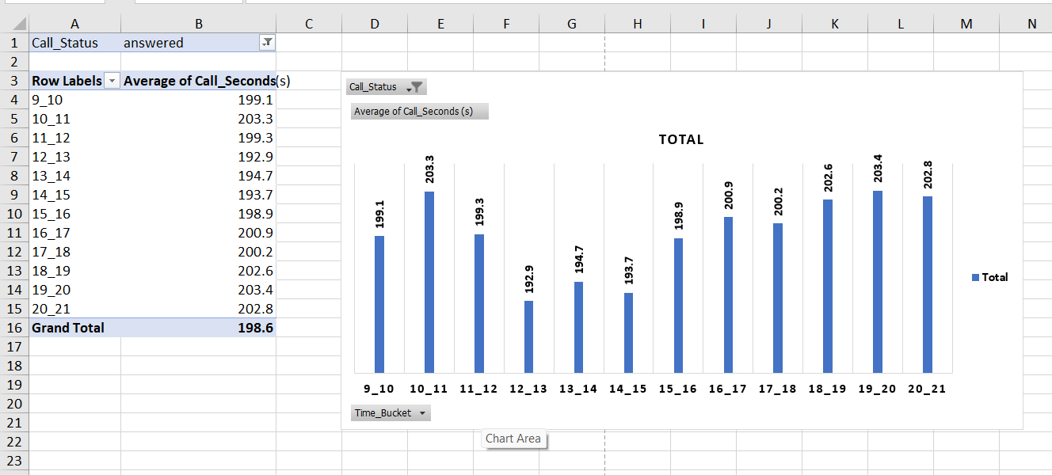
1. average call time duration
can be observed to be 198.6seconds

Slide 5
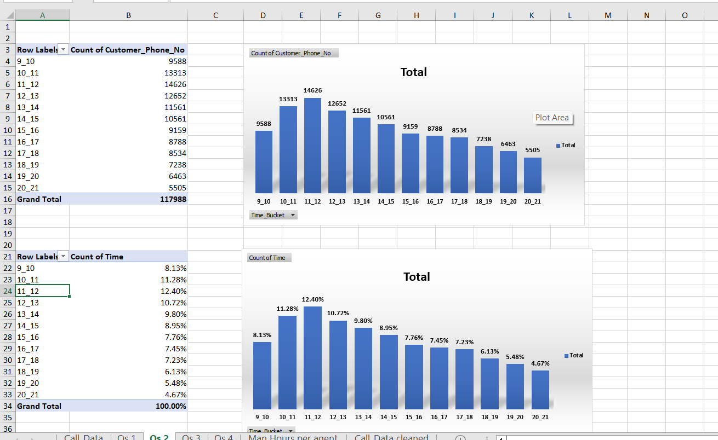
AREAS OF GROWTH

Slide 6
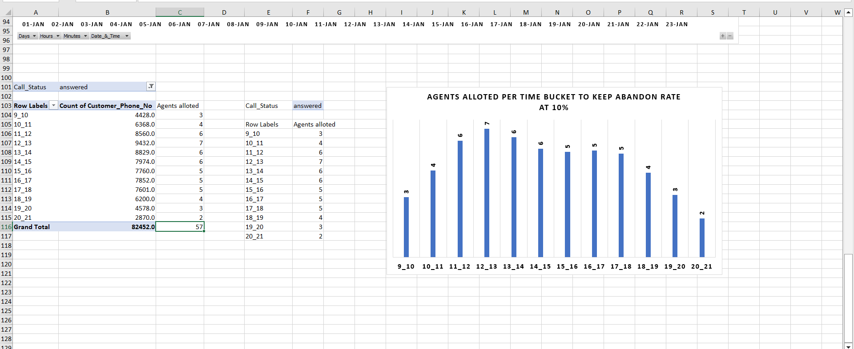
minimum number of agents required in each time bucket so that at least 90 calls should be answered out of 100(10% abandon rate)

Slide 7
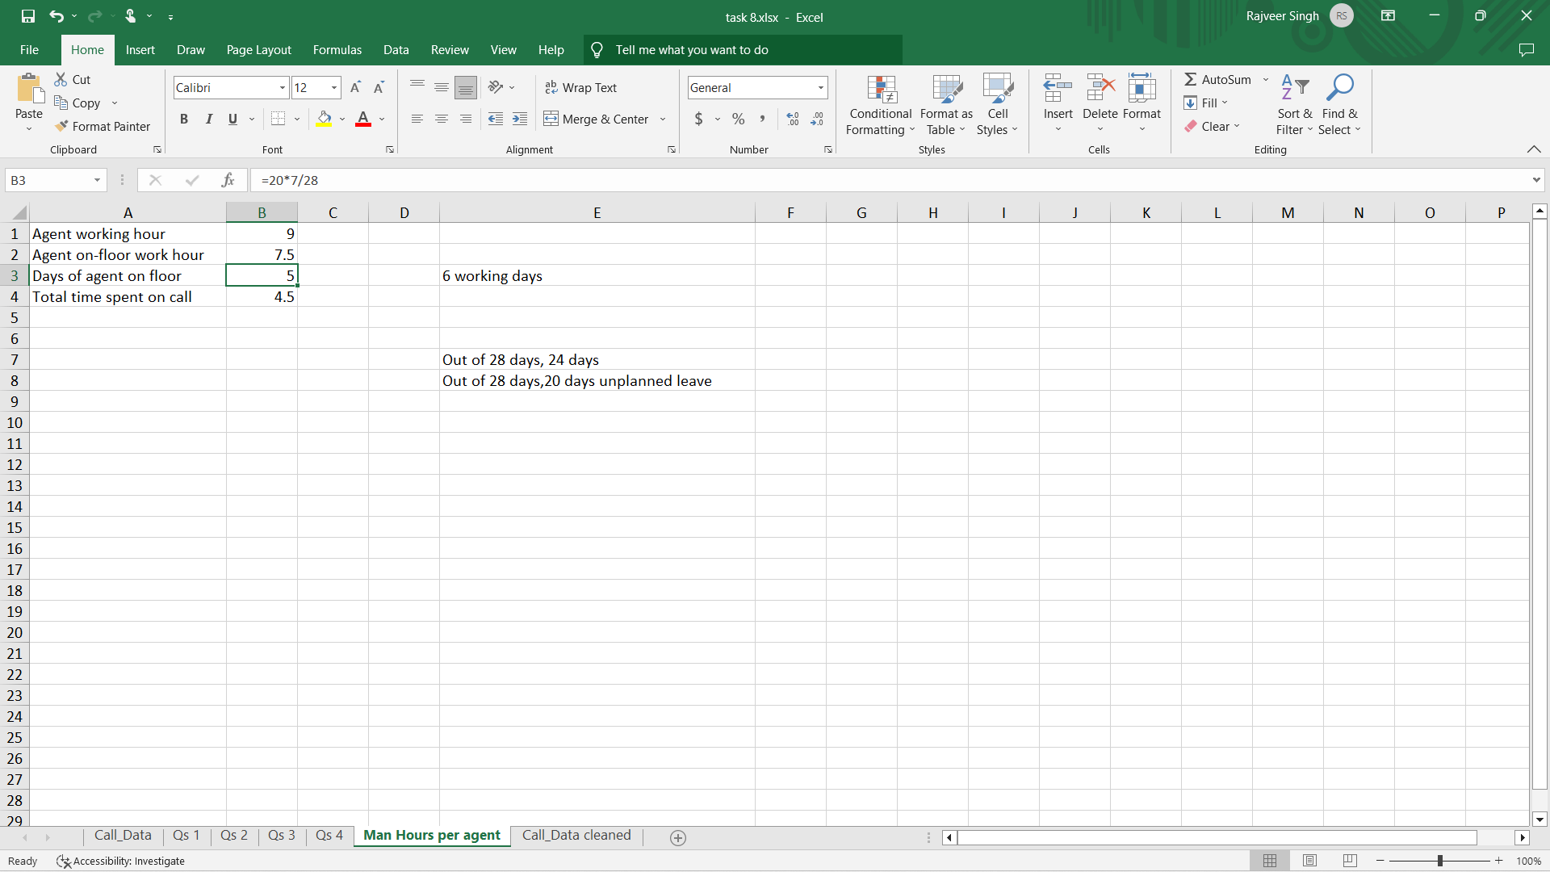
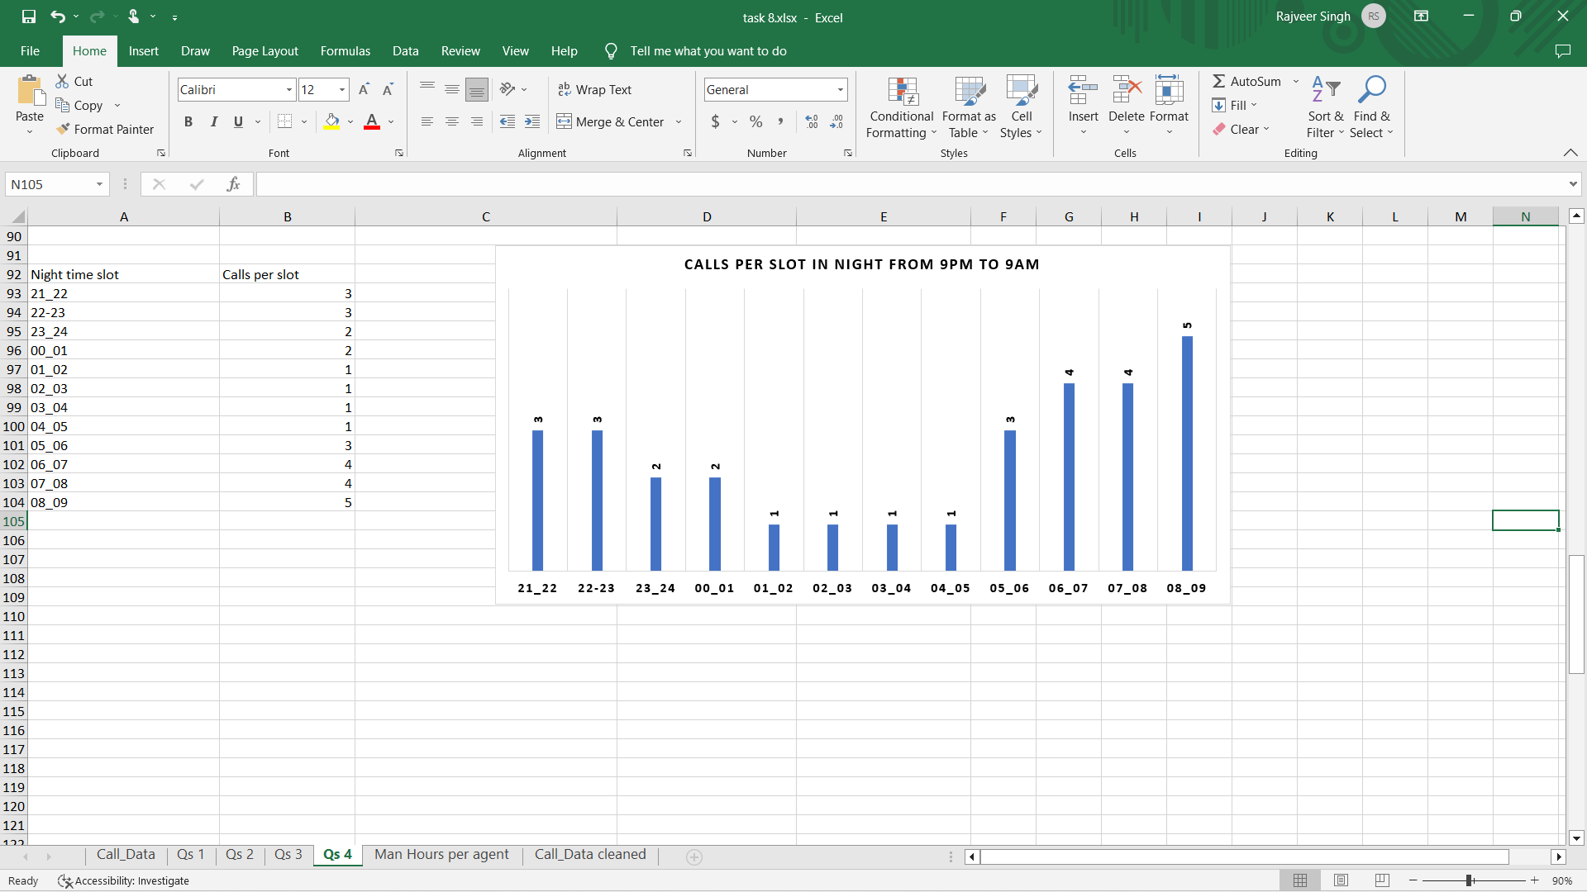
Considering the data provided and separating the night call details to determine night call requirement, we can determine that we need an additional of 17 agents which brings the total agent count to 74

Slide 8

Conclusions
Average call time duration can be observed to be 198.6seconds.
Highest number of calls happen at 12-1 pm time bucket.
57 agents are to be added for 10% abandon rate.
17 additional agents for the night time callers to avoid bad image .
A total of 74 agents will be present.

